Slide 1

ME 617: Manufacturing of Polymers and Polymer Composites
Tensile Behaviour of CNTs(0.50%) based Carbon/Glass Reinforced Hybrid Composites
Submitted by:
Akash Dewangan (234103212)
Dileswar Meher (234103216)
Saurabh Pal (234103223)

Slide 2
Content
Abstract
Introduction
Methodology
Results
Discussion
Conclusions
References
Acknowledgement

Slide 3
Abstract
The tensile behavior of hybrid composites reinforced with glass fiber, carbon nanotubes (CNTs), and carbon fibers will be studied in this work.
The composite material is made up of a mixture of glass and carbon fibers embedded in a polymer resin matrix, with 0.50 percent of its weight consisting of CNTs.
Tensile tests were performed on samples of conventional carbon/glass hybrid composites and those improved with carbon nanotubes.
These results indicate that carbon nanotubes (CNTs) can enhance the mechanical properties of carbon/glass hybrid composites, which could be used in high-strength and high-stiffness fields.

Slide 4
Introduction
Hybrid composites combine the strengths of different reinforcing materials, attracting attention across various industries.
The inclusion of carbon nanotubes (CNTs), known for their high tensile strength, aspect ratio, and excellent conductivity, can further enhance these composites.
The objective of this study is to evaluate the impact of 0.50% CNTs by weight in carbon/glass fiber-reinforced hybrid composites on their tensile and bending behavior.
Through tensile and 3-point bending testing, this research aims to understand how CNTs affect tensile strength, modulus, and elongation at break.
The results could lead to advanced composite materials with applications in aerospace, automotive, and construction, where high strength and stiffness are critical.

Slide 5
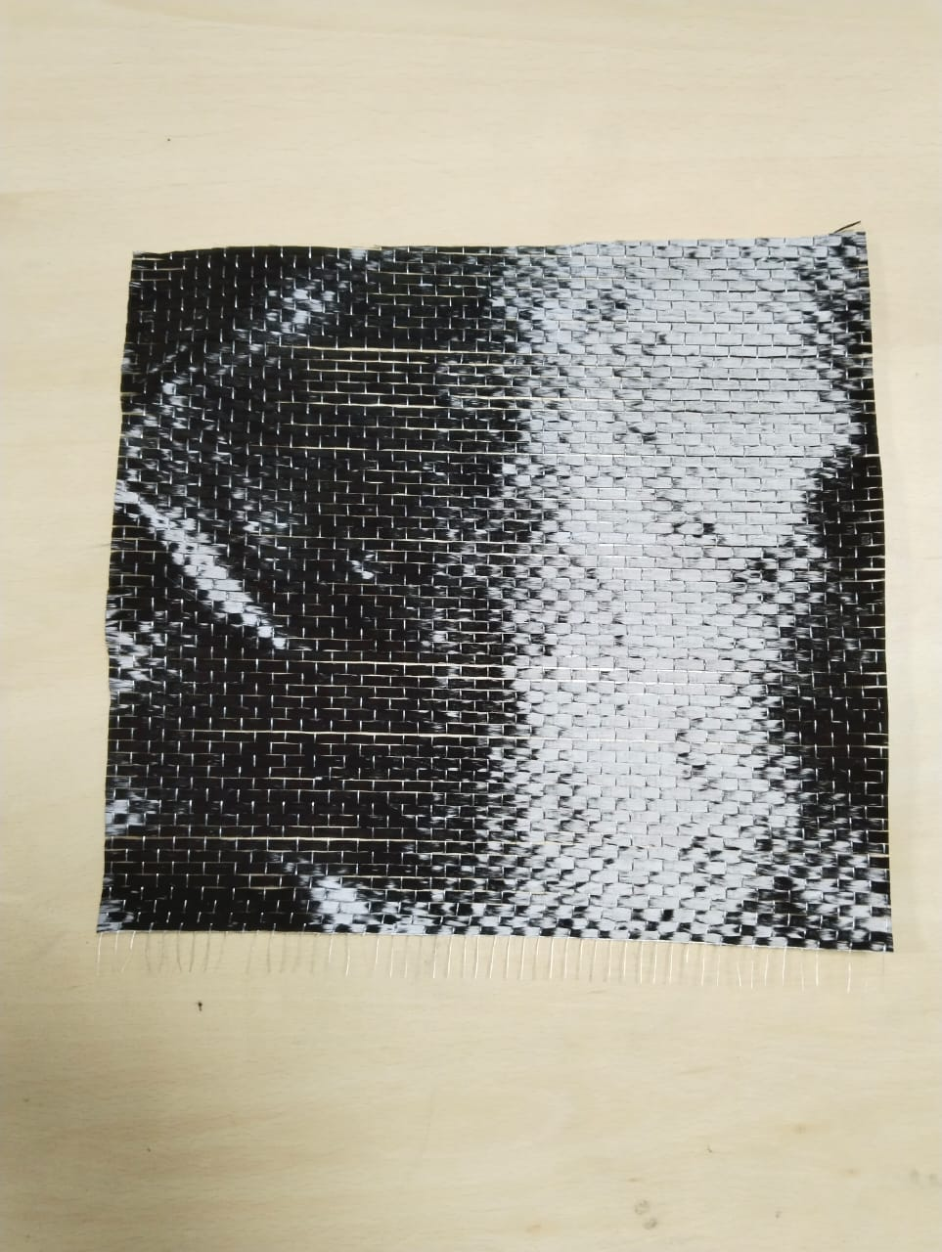
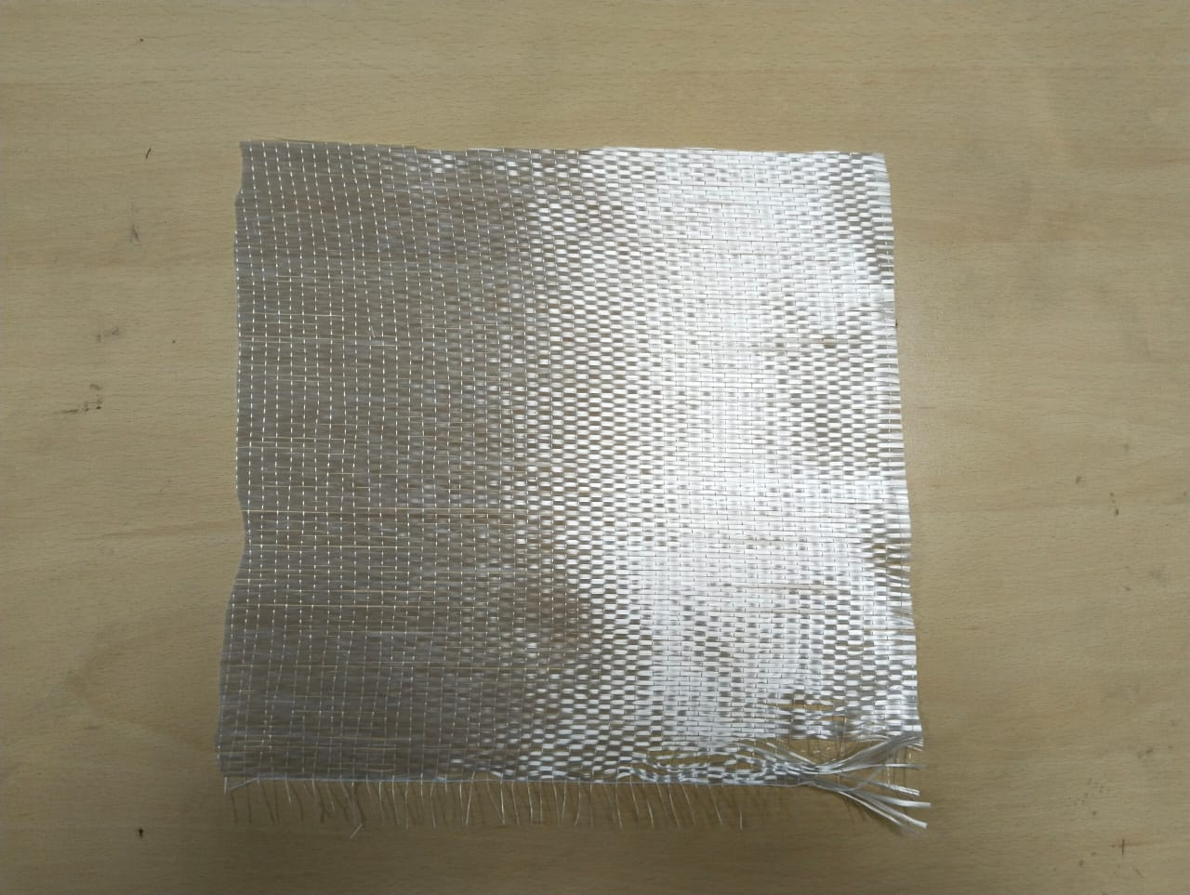
Methodology
Material Selection: Uni-directional carbon fibers, uni-directional glass fibers, and a polymer resin matrix. Carbon nanotubes (CNTs) were incorporated at a concentration of 0.50% by weight.
Fig:1 Uni-directional carbon fiber Fig:2 Uni-directional glass fiber
Composite Fabrication: Using the Hand lay-up process carbon and glass fibers were arranged in alternating layers. The CNTs were mixed into the polymer resin matrix, ensuring uniform dispersion.

Slide 6
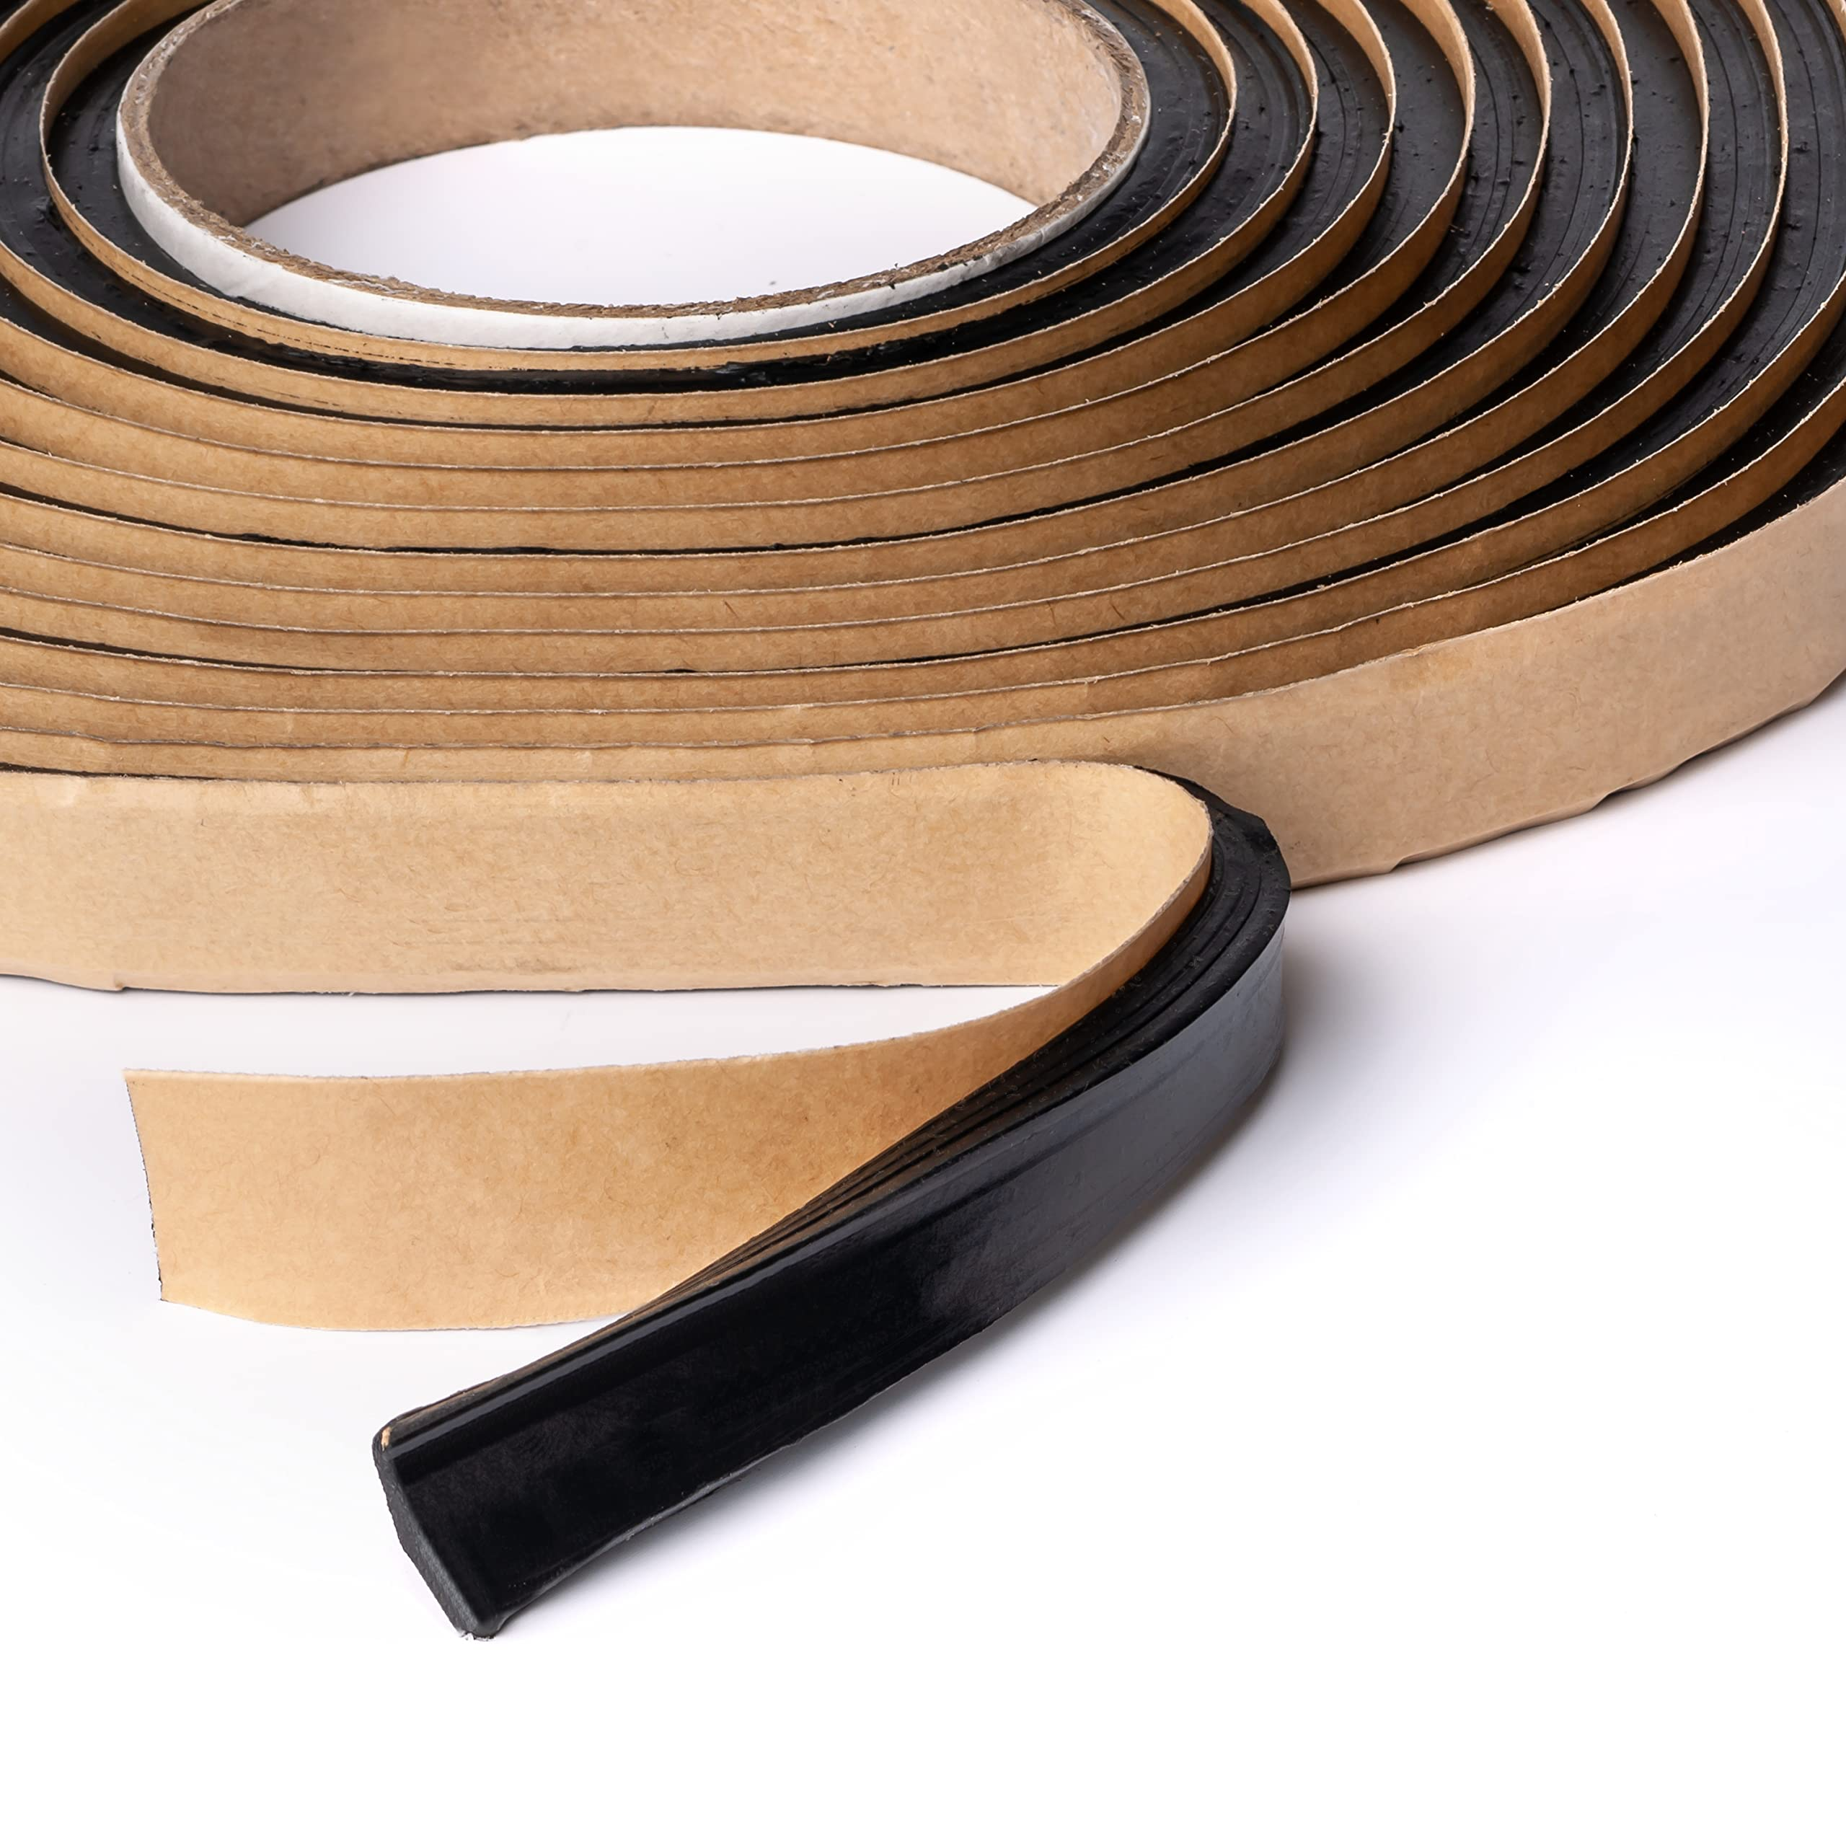
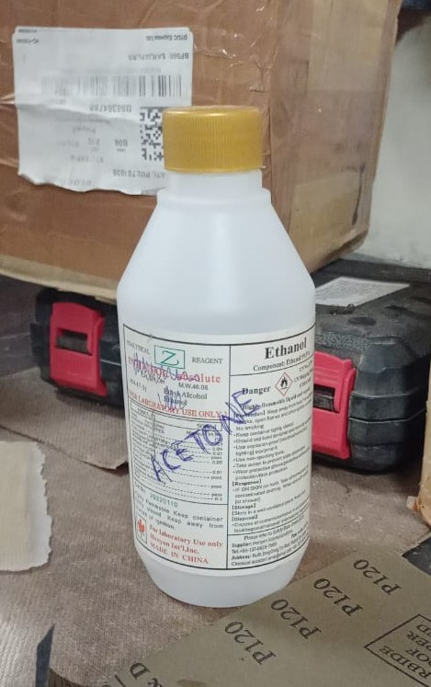
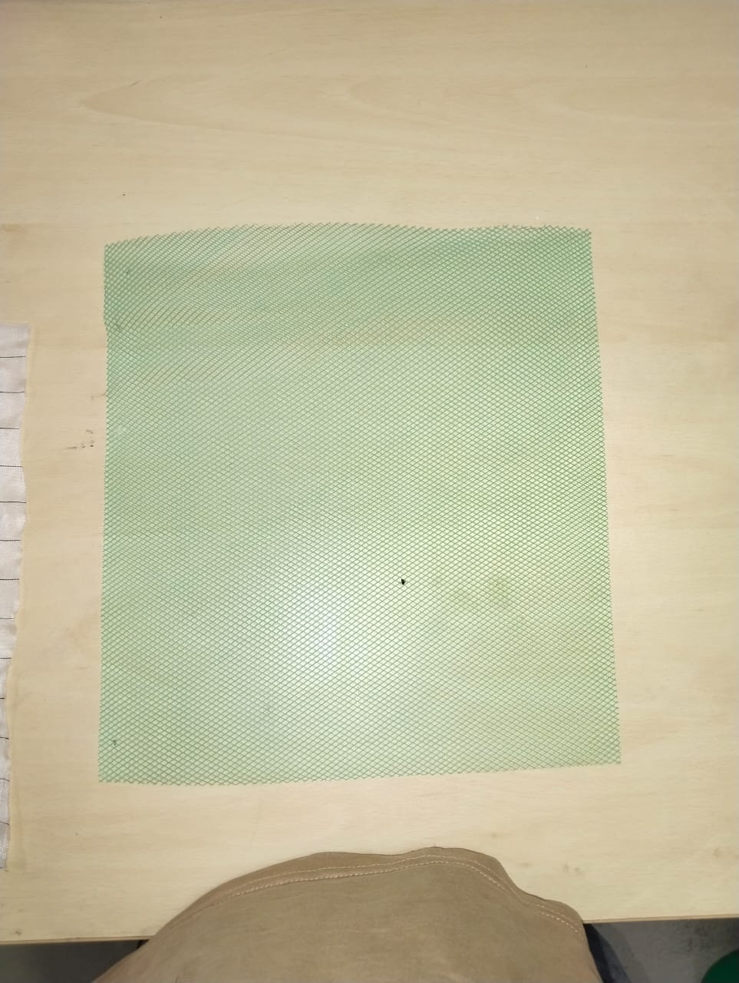
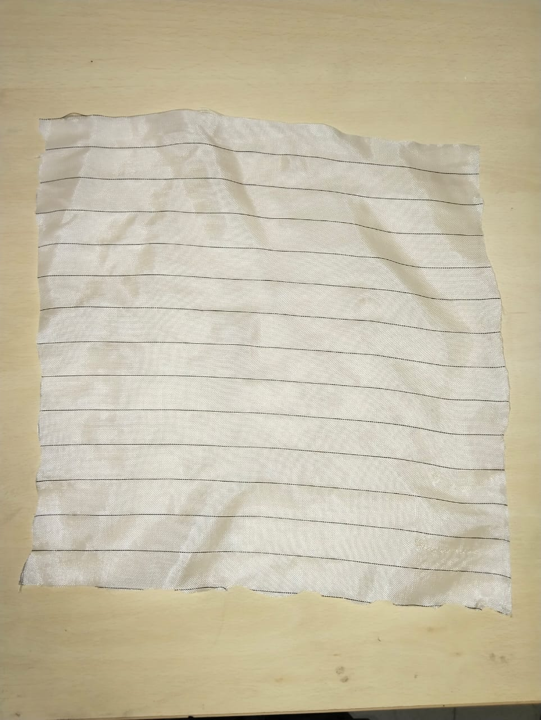
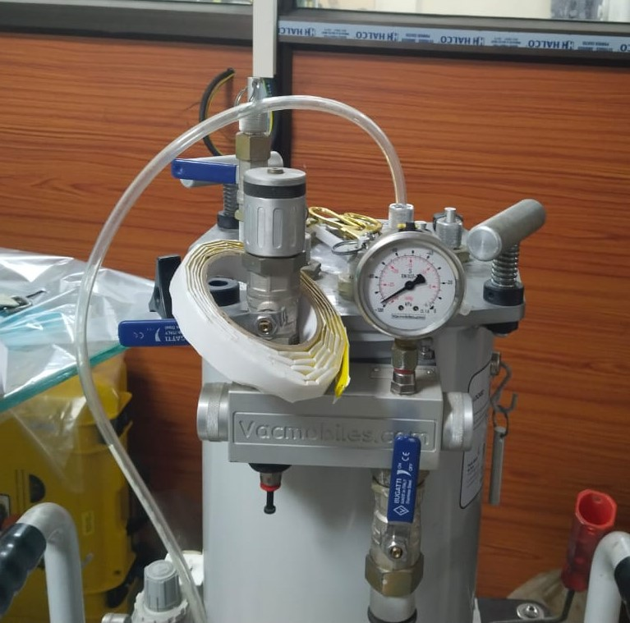
Methodology Contd..
Sample Preparation: After curing, test specimens were prepared for tensile test specimens and were cut according to the ASTM D3039 standard, and 3-point bending test specimens were prepared following ASTM D790.
Sealant Acetone mesh ply peel ply vacuum chamber

Slide 7
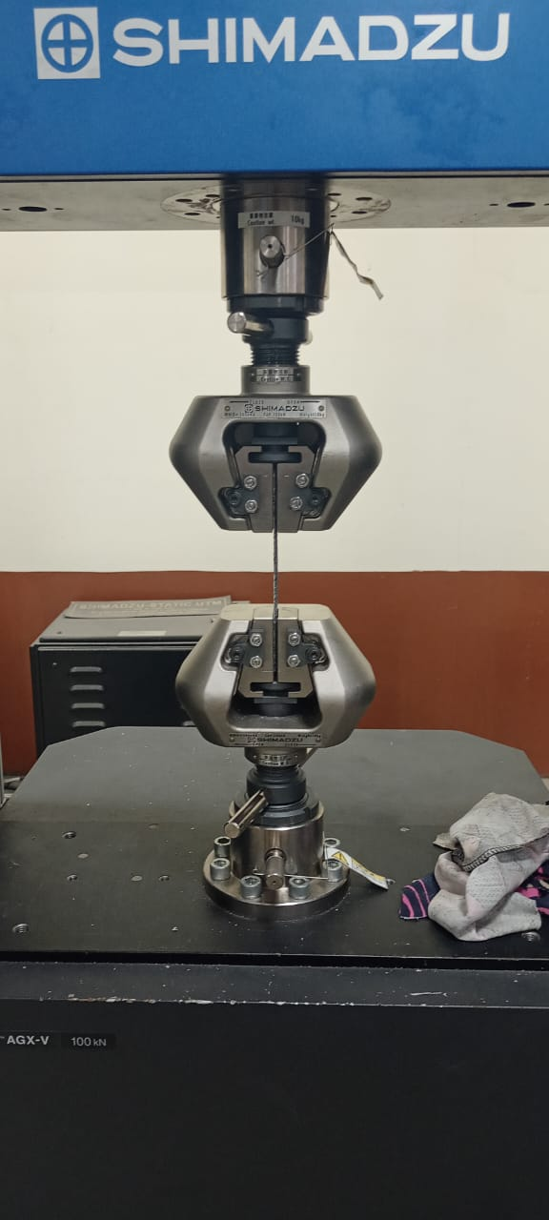
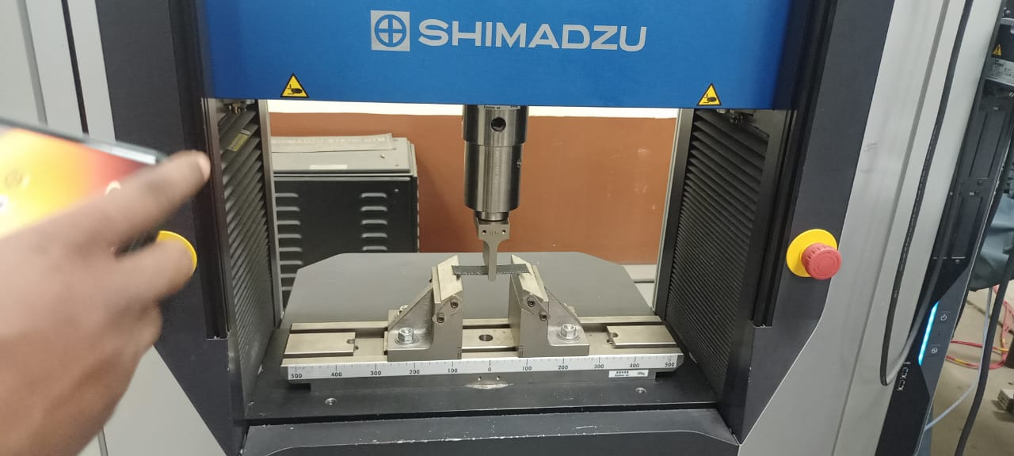
Contd...
Tensile Testing: Tensile testing was conducted using a universal testing machine (UTM). The test measured tensile strength, tensile modulus, and elongation at break.
3-Point Bending Test: Using a universal testing machine, Specimens were placed on two supports. This test measured flexural strength, flexural modulus, and the maximum deflection at the point of failure.
Tensile test
3-Point Bending Test

Slide 8
Process Parameters
Vacuum pressure
Curing time
Resin permeability
Resin viscosity

Slide 9
Results of Tensile Test
Fig. 1. Stress vs Strain Graph
Fig. 2. Force vs Displacement

Slide 10
Results of 3-Point Bending Test
Fig. 3. Stress vs Strain Graph
Fig. 4. Force vs Displacement

Slide 11
Discussion
Strength of commercially carbon fiber reinforced composite in general 1.2 GPa . From the experiment it shown in the result that after adding 0.5% CNTs tensile strength become 1.15 GPa.
The mechanical properties have been enhanced with the incorporation of glass fiber and carbon fiber with CNTs.

Slide 12
Conclusions
The tensile and bending test was done to understand the mechanical properties of the hybrid material and mostly with the incorporation of CNTs the strength is enhanced with some of the other properties.
Observed the process of manufacturing the carbon and glass enforced fiber by Hand Lay-up and Vacuum Bagging method and its process parameters.

Slide 13
References
Amar, Thakur Abhinav, Amit Kumar, and D. K. Yadav. "A Comparative Study on the Properties of Carbon Fiber-Reinforced Polymer Composites Developed by Hand Layup and Vacuum Bagging Molding Techniques." Journal of The Institution of Engineers (India): Series D (2024): 1-13.https://doi.org/10.1007/s40033-023-00631-2

Slide 14
Acknowledgments
Working on the project “Tensile Behaviour of CNTs(0.50%) based Carbon/Glass Reinforced Hybrid Composites” is a source of immense knowledge. We are highly grateful to Dr. Ujendera Kumar Komal, Assistant Professor, Department of Mechanical Engineering (IITG) for providing this opportunity. The constant guidance and encouragement received from P Rakesh (TA) has been of great help in carrying out the project work and is acknowledged with reverential thanks.

